Slide 1
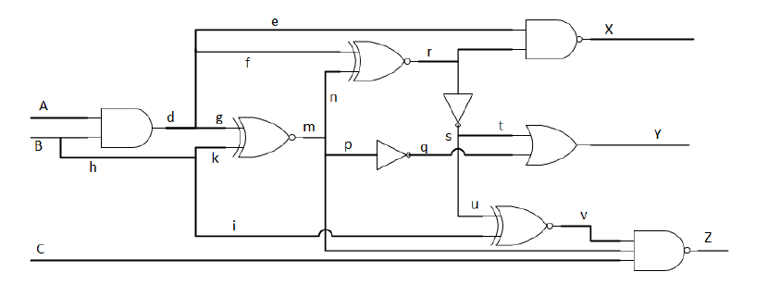

SS@0
DALG
d – SS@0
EE658 – Diagnosis and Design of Reliable Digital Systems
Professor Tabar
Fei Wu

Slide 2
SS@0
Note: Gate are shown using the letter representing their output. The content of D-frontier and J-frontier are gates, and not nodes.

Slide 3
D-alg()
D
D-frontier: {}
J-frontier: {}

Slide 4
Imply & Check
D
D
D
D-frontier: {m,r,x}
J-frontier: {}

Slide 5
Imply & Check
D
D
1
D
1
D-frontier: {m,r,x}
J-frontier: {}

Slide 6
Imply & Check
D
D
1
D
1
D-frontier: {m,r,x}
J-frontier: {}

Slide 7
Imply(PI_B, 1)
Imply & Check
D
D’
D
1
1
D
1
SS@0
1
D
D
0
D
D
0
D’
1
1
D’
1
0
0
1
1
D
Note: error is at the output
SUCCESS
T = {1, 1, X}

